Slide 1

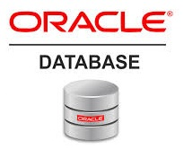
Oracle database
Lecture 45

Slide 2

Today’s Agenda
Creating Functions In PL-SQL
Calling Functions
Calling Procedures/Functions From SQL Prompt
Obtaining Details Of Procedures And Functions
Dropping Procedures And Functions

Slide 3
Syntax Of Creating A Function
CREATE OR REPLACE FUNCTION <function_name> (<variable_name>IN/OUT/IN OUT <datatype>, <variable_name>IN/OUT/IN OUT <datatype>,...) <return type> IS/AS variable/constant declaration;
BEGIN
-- PL/SQL subprogram body;
return value;
EXCEPTION
-- Exception Handling block ;
END <function_name>;

Slide 4
Explanation
CREATE or REPLACE FUNCTION is a keyword used for specifying the name of the function to be created.
Function_name is for function’s name and variable_name is the variable name for variable used in the function
BEGIN, EXCEPTION and END are keywords used to indicate different sections of the function being created.
RETURN is a keyword followed by a datatype specifying the datatype of a value that the function will return.

Slide 5
Exercise
Create a function called SumNos which accepts 2 nos as argument , adds them and returns the result.
Finally call it by accepting input from the user

Slide 6
Defining
CREATE OR REPACE FUNCTION SumNos(a IN number, b IN number) Return Number IS
c number;
BEGIN
c := a+b;
return c;
END SumNos;

Slide 7
Calling
DECLARE
x number;
y number;
z number;
BEGIN
x := &x;
y := &y;
z:=SumNos(x,y);
dbms_output.put_line(‘Sum is ‘||z);
END;

Slide 8
Exercise
Create a function called UpdatePrice which accepts a bookid and an amount as argument ,and increases the bookprice of that book by adding the given amount to it in the ALLBOOKS table.
Finally it should return True or False depending on whether the bookprice was updated or not

Slide 9
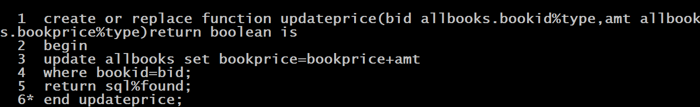
Defining

Slide 10
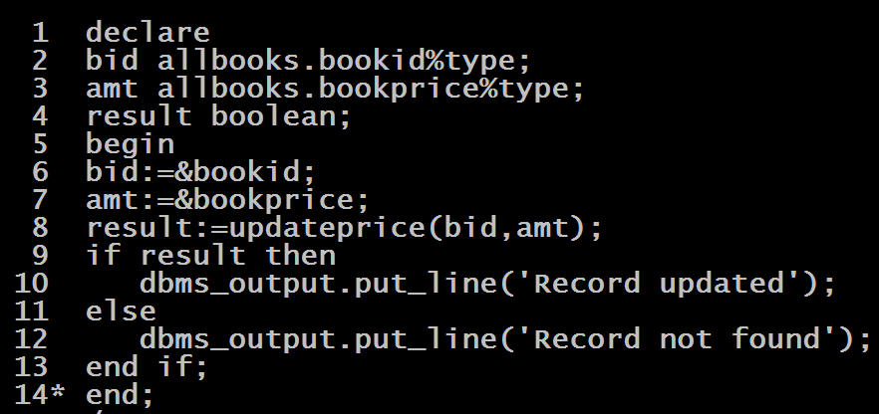
Calling

Slide 11
Calling Procedure From SQL Prompt
A standalone procedure can be called using the EXECUTE keyword.
The following shows the syntax for executing a procedure:
EXECUTE procedure_name( arguments);
Or
EXEC procedure_name( arguments);

Slide 12
Exercise
Create a procedure called AddBook which accepts a bookid,bookname,bookprice and subject as argument and adds the given book to the ALLBOOKS table.
Finally it should display the message whether the book was added or not

Slide 13
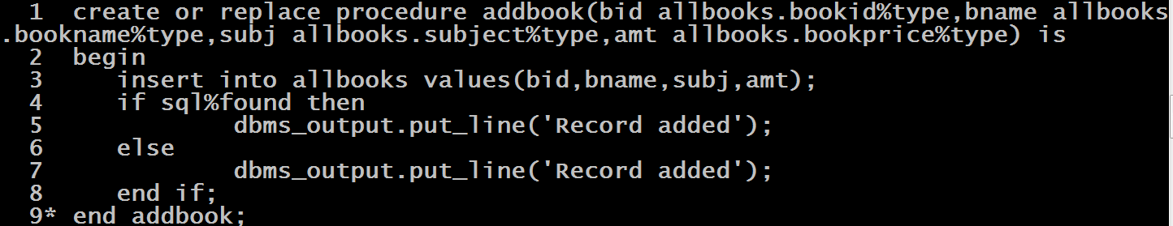
Defining

Slide 14
Calling

Slide 15
Calling Functions From SQL Prompt
A standalone function can be called from SQL prompt as a part of SELECT statement
The following shows the syntax for calling a function:
SELECT <func_name>(<arg>) FROM dual;

Slide 16
Exercise
Create a function called getCount which accepts a subject as argument and returns number of books belonging to that subject from the ALLBOOKS table.

Slide 17
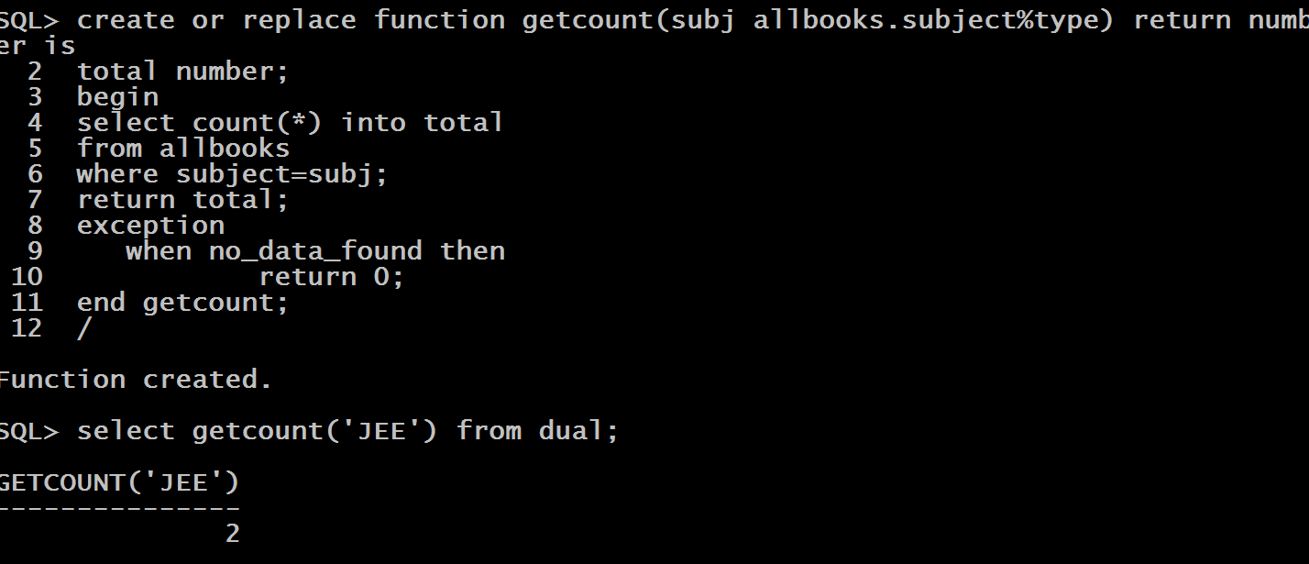
Defining And Calling

Slide 18
Points To Remember
If we are calling a procedure or function from SQL prompt then all the arguments must be accepted in the IN mode.
The data type returned by a function must be an SQL type.
No DML operations are allowed in function although in procedure we can perform these operations

Slide 19
Obtaining Details
Oracle internally stores the details regarding procedures and functions in three dictionaries:
User_Objects
User_Source
User_Errors

Slide 20
Queries
SELECT object_name,object_type,status
FROM user_objects
WHERE object_name=‘<PROC OR FUNC NAME>’;
SELECT text
FROM user_source
WHERE name=‘<PROC OR FUNC NAME>’;
SELECT line,text
FROM user_errors
WHERE name=‘<PROC OR FUNC NAME>’;

Slide 21
Removing Procedure Or Functions
If we want to remove our procedures or functions then the command to be used is DROP command as shown below:
DROP PROCEDURE <proc_name>;
DROP FUNCTION <func_name>;

